Slide 1
MATLAB Tutorial 11
ENME 303 Computational Methods for Engineers
Gathered by
Parham Oveissi

Slide 2
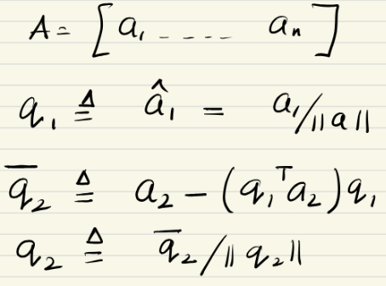
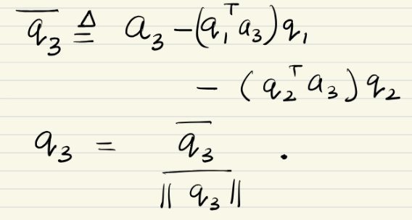
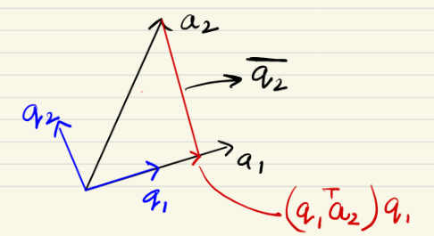

Orthogonalization
Orthonormal vectors:
$q_{i}^{T}q_{j}=\left\{\begin{aligned}0 if i≠j \\ 1 if i=j\end{aligned}\right.$
Orthogonalization:
Given $A$, find $Q$such that $ℛ(A) =ℛ(Q)$ and $Q^{T}Q=I$
Orthogonalization Process:

Slide 3
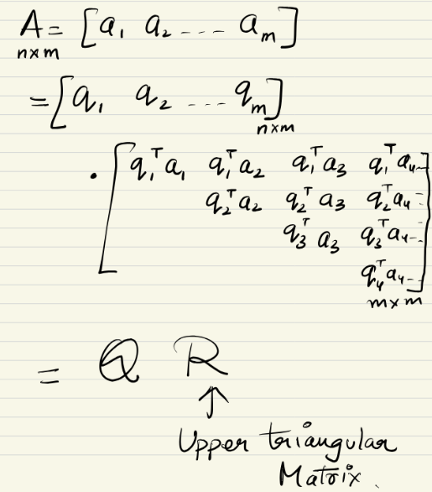
QR Factorization

Slide 4
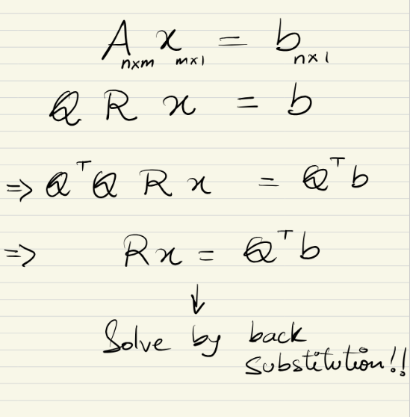

Solving $Ax=b$

Slide 5
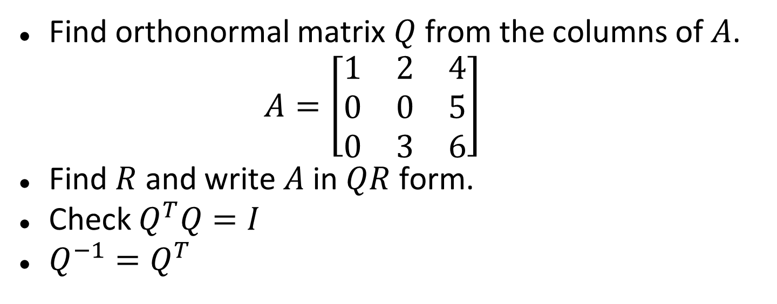
Practice
Find orthonormal matrix $Q$ from the columns of $A$.
$$A=\left[\begin{matrix}1 & 2 & 4 \\ 0 & 0 & 5 \\ 0 & 3 & 6\end{matrix}\right]$$
Find $R$ and write $A$ in $QR$ form.
Check $Q^{T}Q=I$
$Q^{−1}=Q^{T}$

Slide 6
Thanks!

